Slide 1
Neuro 101:
Nursing Neuro Assessment
Kristen Ankrom, RN, SCRN, CCCC
Stroke Coordinator
Coliseum Medical Centers

Slide 2
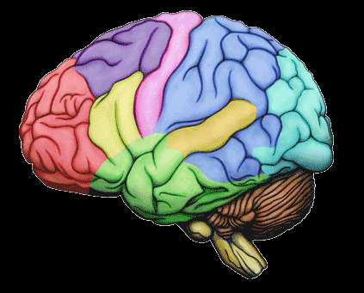
Initial Assessment-
Comprehensive Exam
Should cover the following critical areas:
  Level of Consciousness and mentation
  Movement
  Sensation
  Cerebellar Function
  Reflexes
  Cranial Nerves
This initial exam will establish baseline data with which to compare subsequent assessment findings

Slide 3
The Single Most Important Assessment-
Level of Consciousness (LOC) & Mentation
A change in either is usually first clue to deteriorating condition
Helps to be familiar with terminology used to describe LOC

Slide 4
LOC Terminology
Full consciousness- Patient is alert, attentive, and follows commands. If asleep, responds promptly to external stimulation and, once awake, remains attentive.
Lethargic- Patient is drowsy but awakens—although not fully—to stimulation. Will answer questions and follow commands, but slowly and inattentively.
Obtunded- Patient is difficult to arouse and needs constant stimulation in order to follow a simple command. May respond verbally with one or two words, but will drift back to sleep between stimulation.
Stuporous- Patient arouses to vigorous and continuous stimulation; typically, a painful stimulus is required. May moan briefly but does not follow commands. Only response may be an attempt to withdraw from or remove the painful stimulus.
Comatose- Patient does not respond to continuous or painful stimulation. Does not move—except, possibly, reflexively—and does not make any verbal sounds.

Slide 5
LOC
Since these and other terms used to categorize LOC are frequently used imprecisely, you'd be wise to avoid using them in your documentation. ^{1,2} Instead, describe how the patient responds to a given stimulus. For example, write: “Mr. Smith moans briefly when sternum is gently rubbed, but does not follow commands.”‖⁷
***Remember that recognizing and describing a change in LOC is more important than appropriately naming it. ***³

Slide 6
LOC Assessment Tools
Stroke Patients
  You will use the National Institutes of Health (NIH) Stroke Scale. (http://www.stroke.org/we-can-help/healthcare-professionals/improve-your-skills/tools-training-and-resources/training/nih)
Typically, it is the Glasgow Coma Scale (GCS) that is used to assess LOC.
  Specifically, it is useful in evaluating patients during the acute stages of head injury.

Slide 7
Glasgow Coma Scale
Based on 3 patient responses:
  Eye opening
  Motor response
  Verbal response
Patient receives score for best response in each of these areas (score is added together).
  Score range from 3-15.
  Higher the number, the better.
  <8 usually indicates COMA.

Slide 8
Mentation
If patient is alert or awake enough to answer questions, you will assess mentation by asking the following questions to determine orientation to person, place, and time:
  What is your name?
  Where are you right now?
  Why are you here?
  What year is it?
  Who is the president?

Slide 9
Pupils
Assessment of pupils is especially important in a patient with impaired LOC.
Similar to change in LOC, change in Pupil size, shape, or reactivity can indicate increasing intracranial pressure (ICP) from a mass or fluid. ⁷
  Pupils will be covered as part of cranial nerve assessment

Slide 10
Assessing for Signs of
Motor Dysfunction
Patient must be awake, willing to cooperate, & able to understand what you are asking
With patient in bed, assess motor strength bilaterally. Have the patient:
  Flex and extend arms against your hand
  Squeeze your fingers
  Lift leg while you press down on thigh
  Hold leg straight and lift against gravity
  Flex and extend foot against your hand

Slide 11
Assessing for Signs of Motor Dysfunction- Unconscious Patient
Assess motor response in unconscious patient by applying a noxious stimulus and observing patient’s response.
Another approach is central stimulation, such as sternal pressure-
  Produces an overall body response
  More reliable than peripheral stimulation
  Why?-
    In an unconscious patient, peripheral stimulation, such as nailbed pressure, can elicit a reflex response, which is not a true indicator of motor activity. ⁷

Slide 12
Evaluating Sensation
Patient must be able to cooperate with the exam. Will need to tell you whether the sensation is felt and whether it is felt on both sides of body equally.
  Begin with the feet and move up the body to the face, comparing one side with the other. Assess sensation to light touch using your fingertips or cotton.
  Test superficial pain sensation with a clean, unused safety pin. Also, test sensation using a dull object. The patient should be able to distinguish sharp from dull.
  Test proprioception, or position sense, by moving the patient's toes and fingers up or down. Grasp the digit by its sides and have the patient tell you which way it's pointing. ³

Slide 13
Evaluating Cerebellar Function
Test if indicated, however, testing cerebellar function may not be necessary in a problem-focused exam, and cannot be performed if patient can’t, or won’t, follow commands.
Upper extremities
  If patient is in bed, hold up your finger and have patient quickly and repeatedly move his finger back and forth from your finger to his nose.
  Then have patient alternately touch their nose with their right and left index fingers.
  Finally, have patient repeat these tasks with their eyes closed. Movements should be precise and smooth. ³

Slide 14
Evaluating Cerebellar Function
Lower extremities
  Have patient bend their leg and slide that heel along the opposite shin, from the knee to the ankle. This movement, too, should be accurate, smooth, and without tremors.
If patient is able to stand, you can assess their balance using the Romberg test.
  Have patient stand with their feet together, arms at their sides, and eyes open; he should be able to stand upright with no swaying.
    If he can do that, have him close his eyes and stand the same way.
    If he falls or breaks his stance after closing his eyes, the Romberg test is positive, indicating proprioceptive or vestibular dysfunction. ²

Slide 15
Assessing Deep Tendon Reflexes
Deep tendon reflexes include-
  Triceps
  Biceps
  Brachioradialis
  Patellar
  Achilles tendon
    Not routinely assessed
Should be tested in any patient with a spinal cord injury
Tested with reflex hammer.
  Graded from 0-5+
    0- no reflex
    2+- normal
    5+ hyperreflexia with clonus (repeated rhythmic contractions)

Slide 16
Deep Tendon Reflexes
Biceps- Patient’s arm should be flexed slightly with the palm facing up. Hold arm with your thumb in the antecubital space over the biceps tendon. Strike your thumb with the hammer; the arm should flex slightly.
Triceps- Patient's arm should be flexed 90 degrees. Support the arm and strike it just above the elbow, between the epicondyles; the arm should extend at the elbow.
Brachioradialis- Patient's arm should be flexed slightly and resting on the lap with the palm facing down. Strike the outer forearm about two inches above the wrist; the palm should turn upward as the forearm rotates laterally.
Patellar- With th patient's legs dangling (if possible), place your hand on one thigh and strike the leg just below the kneecap; the leg should extend at the knee.
Achilles tendon- With patient's foot in slight dorsiflexion, lightly strike the back of the ankle, just above the heel; the foot should plantar flex.

Slide 17
Assessing Superficial Reflexes
Plantar reflex is the only superficial reflex that’s commonly assessed and should be tested in comatose patients, and those with suspected injury to lumbar 5-5 or sacral 1-2 areas of the spinal cord.
  Stimulate the sole of the foot with a tongue blade or the handle of a reflex hammer.
    Begin at the heel & move up the foot, in a continuous motion, along the outer aspect of the sole and then across the ball to the base of the big toe. ⁷
Normal response is plantar flexion (curling under) of the toes.
  Extension of the big toe (Babinski’s sign) is abnormal, except in children younger than 2 years. ^{1, 2, 5}

Slide 18
Assessing Brain Stem Reflexes
Assess brain stem reflexes in Stuporous or comatose patients to determine if the brain stem is intact.
  Protective reflexes (coughing, gagging, and the corneal response) will be part of cranial nerve assessment.
Oculocephalic, or doll’s eye, reflex-
  Turn patient’s head briskly from side to side- the eyes should move to the left while head is turned to the right, and vice versa.
    If this reflex is absent, there will be no eye movement.
Oculovestibular reflex (ice caloric or cold caloric reflex)-
  A physician will instill at least 20 mL of ice water into patient’s ear.
    With intact brain stem, eyes will move laterally toward affected ear.
    With severe brain stem injury, gaze will remain at midline.

Slide 19
Assessing the Cranial Nerves
12 pairs of cranial nerves
  Sensory
  Motor
  Both
Assessment of which nerves depends on patient’s diagnosis
  Must have patient cooperation
  Cannot perform complete assessment on comatose patient
Extraocular movements (EOMs) are controlled by cranial nerves III, IV, and VI, which you’ll test together.
Other functions that are dependent on more than one cranial nerve are:
  Pupillary response (CN II and III)
  Corneal reflex (CN V and VII)
  Gag reflex (CN IX and X). ⁷

Slide 20
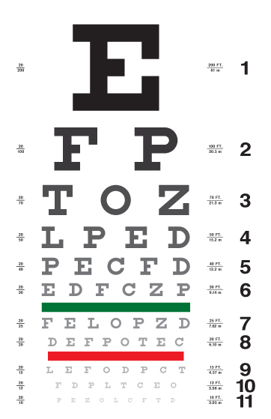
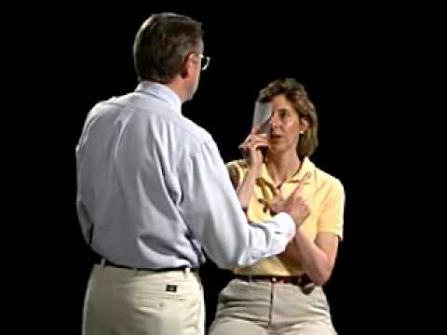
Cranial Nerve II- Visual Fields
This nerve is tested by assessing a person’s vision.

Slide 21
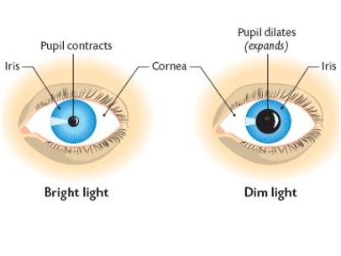
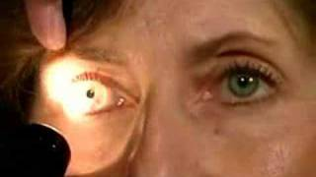
Cranial Nerves II & III-
Pupillary Light Reflex

Slide 22
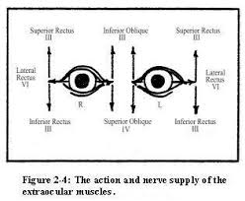
Cranial Nerves III, IV, & VI- Inspection & Ocular Alignment
Have patient “follow your finger with their eyes without moving their head”.
  Move your finger side to side, then up and down (in an “H” pattern)
  Look for failure of movement and nystagmus

Slide 23
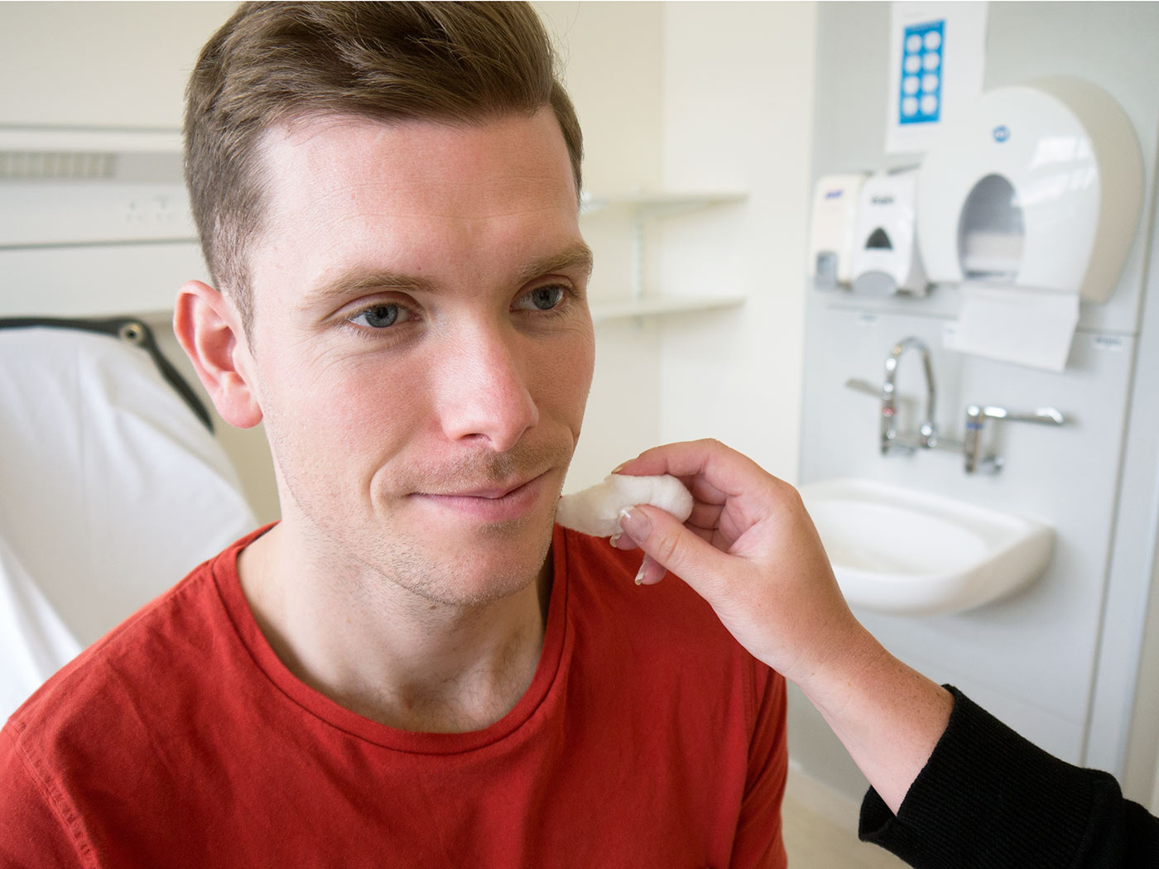
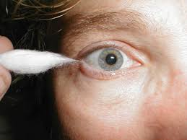
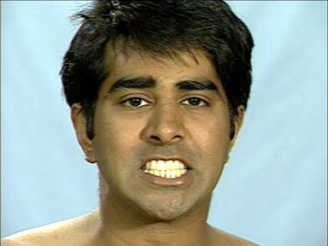
Cranial Nerve V & VII –
Sensory, Corneal Reflex, & Motor
To test for pain, touch, & temperature
  Gently touch patient’s face with clean safety pin & hot and cold objects
Corneal reflex
  Gently use a cotton wisp on the patient’s cornea.
To test motor function
  Have the patient clench their teeth and move their jaw side to side.

Slide 24
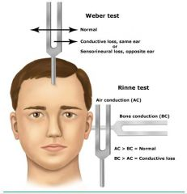
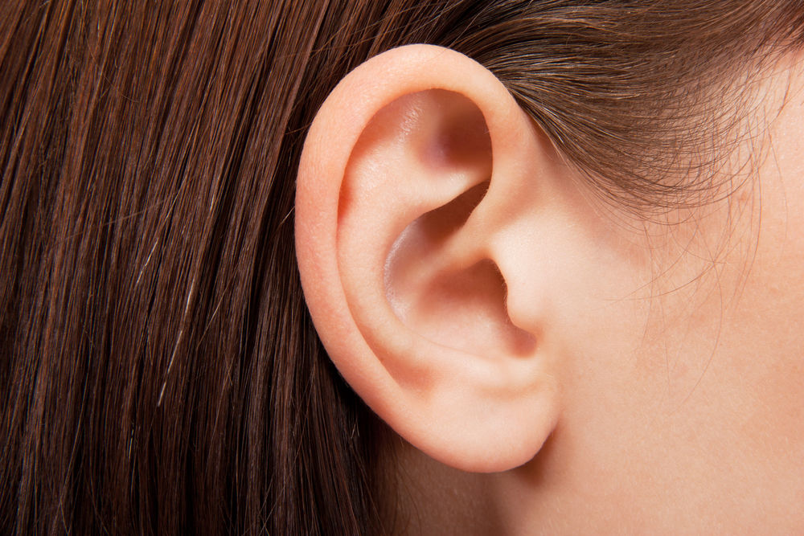
Cranial Nerve VIII
Vestibulo-Cochlear Nerve-
  Whisper in patient’s ear and have them repeat what you said
    If deafness is suspected, perform Rinne’s test and Weber’s test.

Slide 25
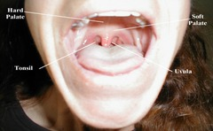
Cranial Nerves IX & X- Motor
Observe ability to cough, swallow, and talk.
Test motor function:
  Ask patient to open mouth and say “ah” while you depress the tongue with a tongue blade.
  Observe soft palate and uvula
    Soft palate and uvula should rise medially.

Slide 26

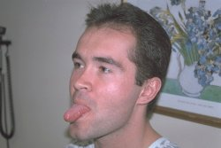
Cranial Nerves XI & XII- Motor
CN XI- Accessory spinal nerve.
  Have patient shrug their shoulders or turn head side to side
CN XII- Controls movement of the tongue.
  Have patient stick out their tongue and assess for midline

Slide 27
Vital Signs & Neuro Status
The brain stem & Vagus nerve (CN X) play an important part in vasomotor tone.
  Conditions affecting these areas can cause vital signs to change
Cushing’s Triad
  Indicates an increase in ICP
    Change in Respirations, often irregular, deep, & bradypnea rate- such as Cheyne Stokes
    Bradycardia
    Increasing systolic BP with widening pulse pressure (the difference between the systolic and diastolic BP)
Cushing’s Triad is a late sign of increased ICP
  Once this begins, brain stem herniation is most likely already in progress & it may be too late to reverse.
  To detect increasing ICP before it reaches this point, be alert for earlier signs: a subtle change in LOC or pupils, for example.

Slide 28
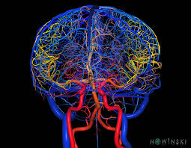
Final Reminders
Accurate & consistent documentation helps ensure that subtle changes in neuro status are caught early.
  Utilize the tools on your unit such as flowchart, EBCD, etc., to compare current to previous findings.
    Through comparison, you’ll be able to spot changes and trends, and when necessary, intervene quickly and appropriately.
Verbal communication is important.
  In many Neuro departments, a bedside neuro exam is done as part of the change-of-shift report, so that the off-going and oncoming nurses can assess the patient together.
Now matter how brief or extensive your neuro assessments are, comparing your findings to those of previous exams is ESSENTIAL!

Slide 29
REFERENCES
1. Marshall, R. S., & Mayer, S. A. (2001). On call neurology (2nd ed.). New York: W. B. Saunders.
2. Vos, H. (2002). The neurologic assessment. In E. Barker (Ed.), Neuroscience nursing: Spectrum of care
(2nd ed.). St. Louis: Mosby.
3. Hickey, J. V. (2003). The clinical practice of neurological and neurosurgical nursing (5th ed).
Philadelphia: Lippincott.
4. Bader, M. K., & Littlejohns, L. R. (2004). AANN core curriculum for neuroscience nursing (4th ed.).
Philadelphia: Saunders.
5. Messner, R., & Wolfe, S. (1997). RN's pocket assessment guide. Montvale, NJ: Medical Economics.
6. Kerr, M. E. (2000). Intracranial problems. In S. M. Lewis, M. M. Heitkemper, & S. R. Dirksen (Eds.),
Medical surgical nursing (5th ed). St. Louis: Mosby.
7. Noah, P (2004) Neurological assessment: A refresher. RN/Drexel Home Study Program Center.
Modern Medicine. Advanstar Communications.
8. Messner, R., & Wolfe, S. (1997). RN's pocket assessment guide. Montvale, NJ: Medical Economics.
9. Movies drawn from the NeuroLogic Exam and PediNeuroLogic Exam websites are used by permission
of Paul D. Larsen, M.D., University of Nebraska Medical Center and Suzanne S. Stensaas, Ph.D.,
University of Utah School of Medicine. Additional materials were drawn from resources provided by
Alejandro Stern, Stern Foundation, Buenos Aires, Argentina; Kathleen Digre, M.D., University of
Utah; and Daniel Jacobson, M.D., Marshfield Clinic, Wisconsin. The movies are licensed under a
Creative Commons Attribution-NonCommerical-ShareAlike 2.5 License.

